Slide 1


How to transition from Non- Data Science to Data Science roles
Get insights into a new age career opportunities
- Rohan Chikorde

Slide 2


Topics
About me
Introduction
Career opportunities in AI
Top must have skills set
Salary of a Data Scientist
How to prepare for a data science interview?
Tips for the transition in Data Science
Q&A

Slide 3


About me:
Vice President – AIML @ BNY Mellon
Been in the industry for ~9 years
Previous companies – General Mills, Accenture, etc
Engineering in CS & PG in Machine Learning
20+ Certifications in DS, ML, DL
Other work:
Technical reviewer/editorial board of Packt Publishing Company
Mentoring and Consulting for AI and ML
https://www.linkedin.com/in/rohan-chikorde/

Slide 4
Introduction

Slide 5
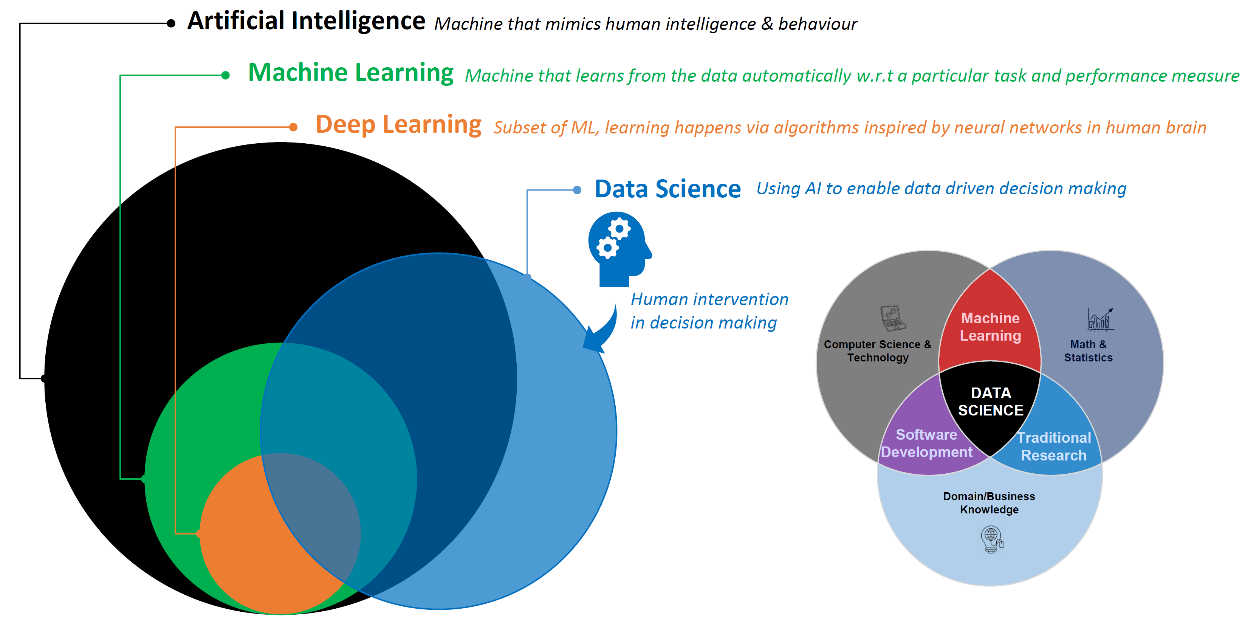

Demystifying buzzwords
Skills Required

Slide 6
Career Opportunities in AI

Slide 7
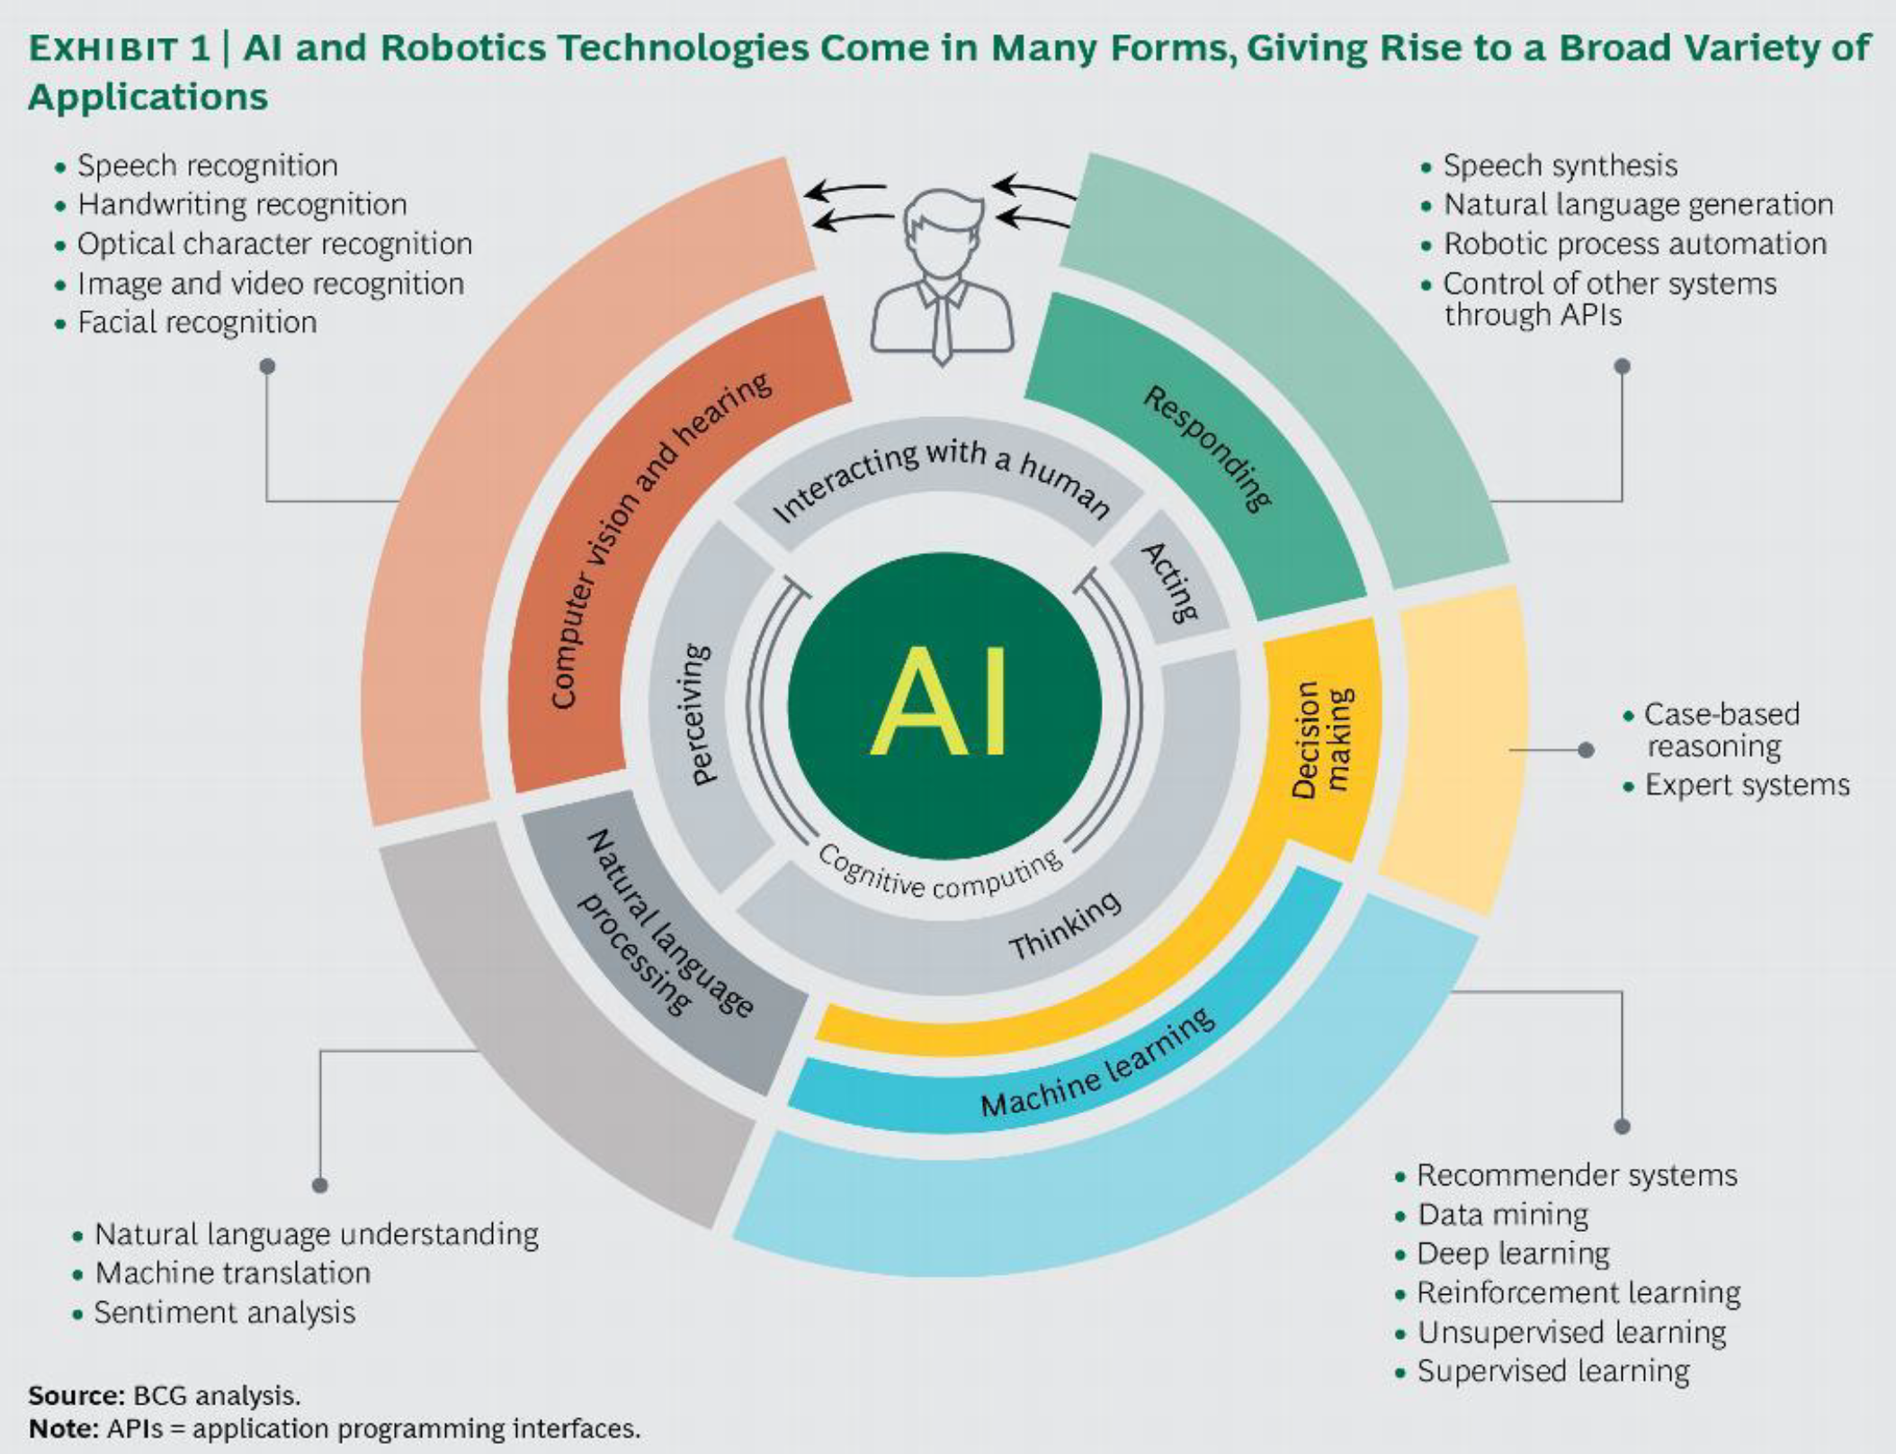
Career Opportunities in AI

Slide 8
Skills A Data Scientist Must Have

Slide 9
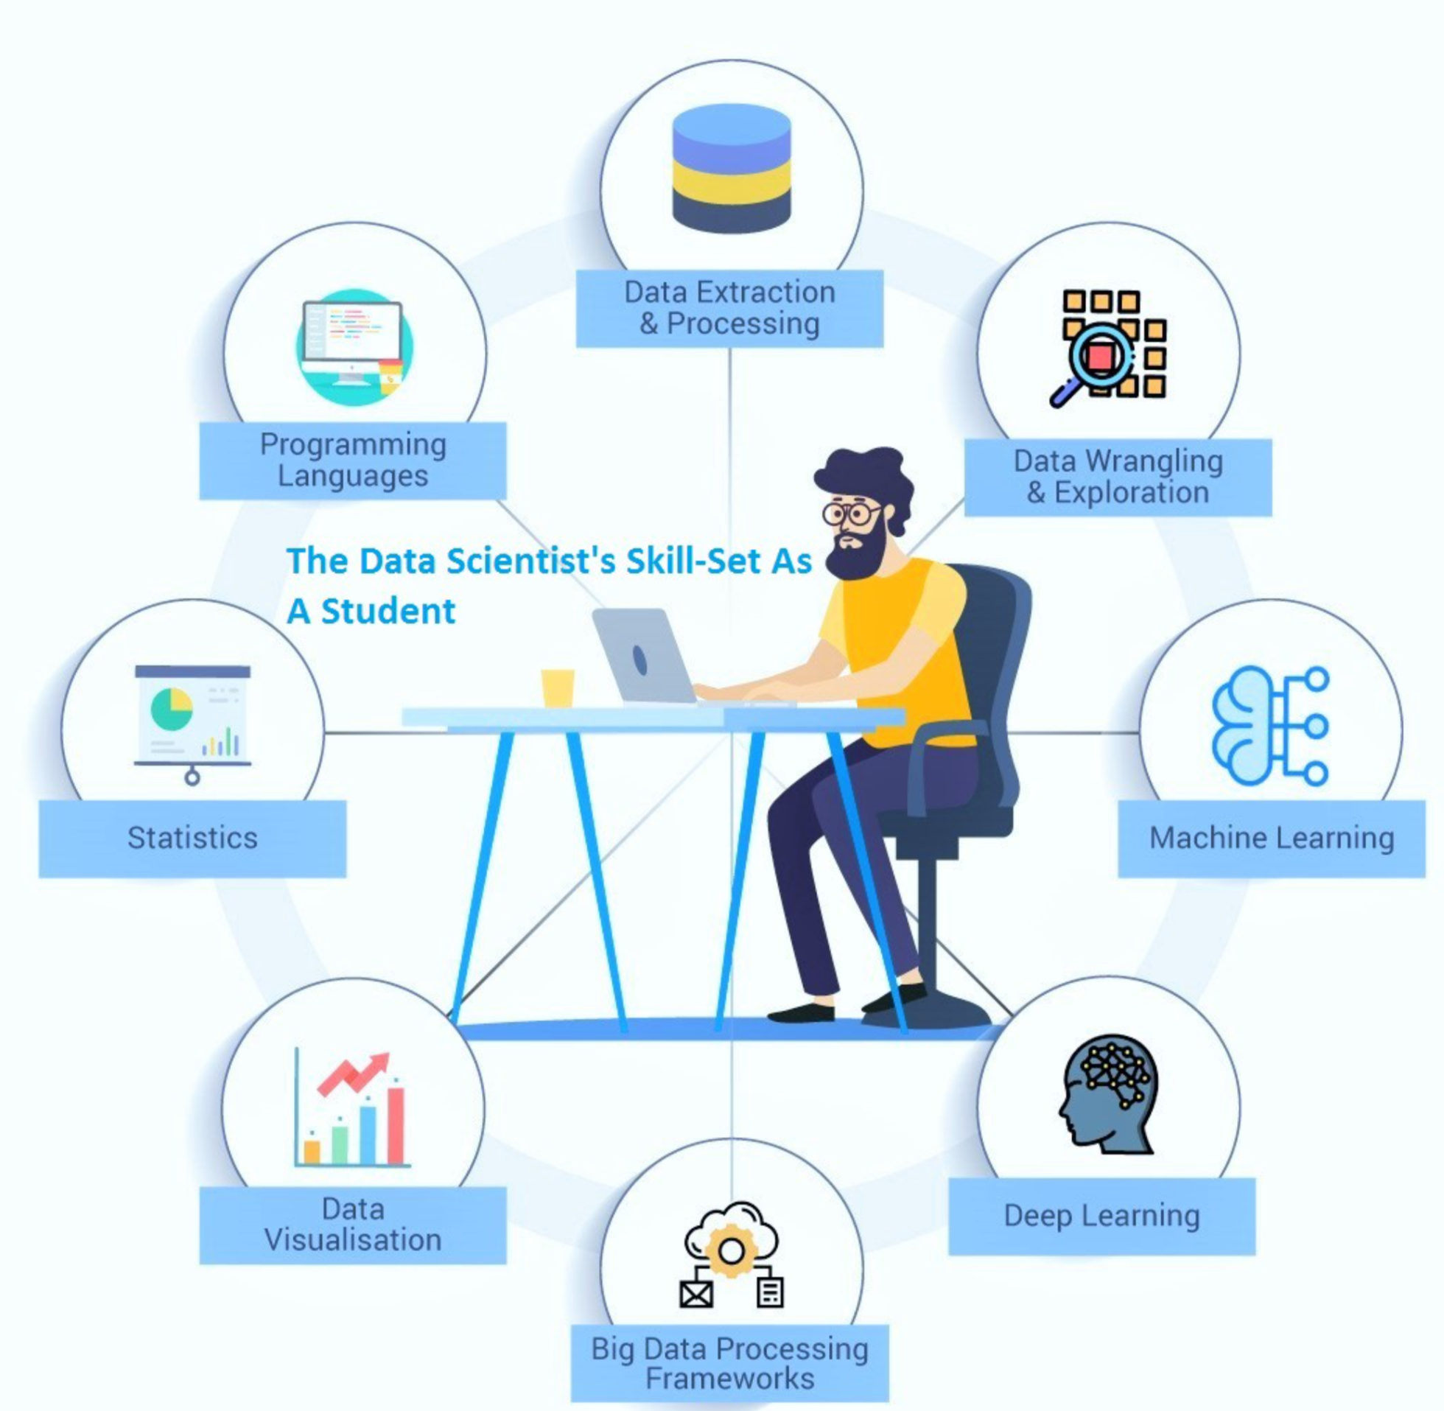
Skills A Data Scientist Must Have
Image Credits: https://medium.com/@minatibiswal_85870/why-you-should-focus-on-improving-developing-the-data-scientists-skill-set-as-a-student-b1d8b295b8f3

Slide 10
How upGrad helps in building a career in Data Science domain
Certification from Best Institutes round the globe
Cutting-edge curriculum
Best-in class faculty
Daily Doubt Resolution Support
Mentorship and Placement Services
Earn certifications from best universities like IIIT-Bangalore, IIMK, University of Arizona, University of Maryland etc
The curriculum of the programs are built by industry leaders and academians keeping industry at the center
The courses are taught by best faculty from industry and institutes to give an all-round exposure to the students
Learn at the time of your own convenience and get your doubts resolved on the same day in the daily doubt resolution sessions
Don’t just learn the skills, but get placement support and all-round development for applying and cracking the job roles
1
2
3
4
5

Slide 11

Value: Most Comprehensive & Personalized Learning Experience in entire higher ed. ecosystem
Advantages
Get practical usable skills + a degree/certificate
Online videos allow watching/rewatching at own pace & deepen conceptual understanding
Live learning helps address doubts and learn in classroom setting
Personalized elements such as PI sessions & industry mentors help deepen personalized understanding & address individual learning gaps
Doubt clearing sessions Q&A forums ensure one gets every small doubt resolved
Learner Need
To have in depth learning of all concepts/no learning gap
To have a learning experience similar to the offline they have experienced earlier
But with more hands on skill based learning
Features
A powerful mix of recorded content and live sessions
1-15 PI sessions
1-1 Industry Mentor Sessions
Doubt Solving Sessions
Integrations of hands on /practical elements such as simulations/case studies/capstone projects

Slide 12
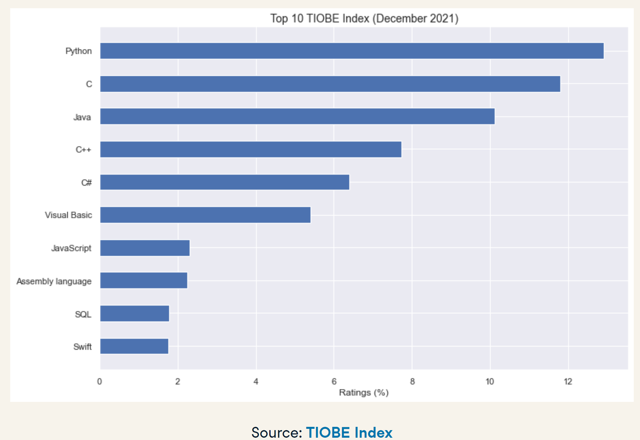
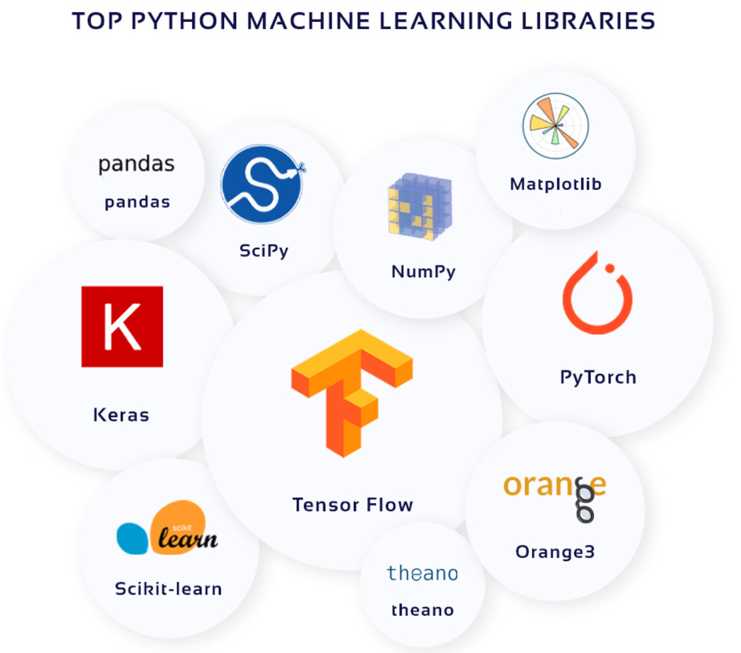
Programming Languages
Image Credits: https://cdn.light-it.net/articles_image/Article62_A1.jpg

Slide 13
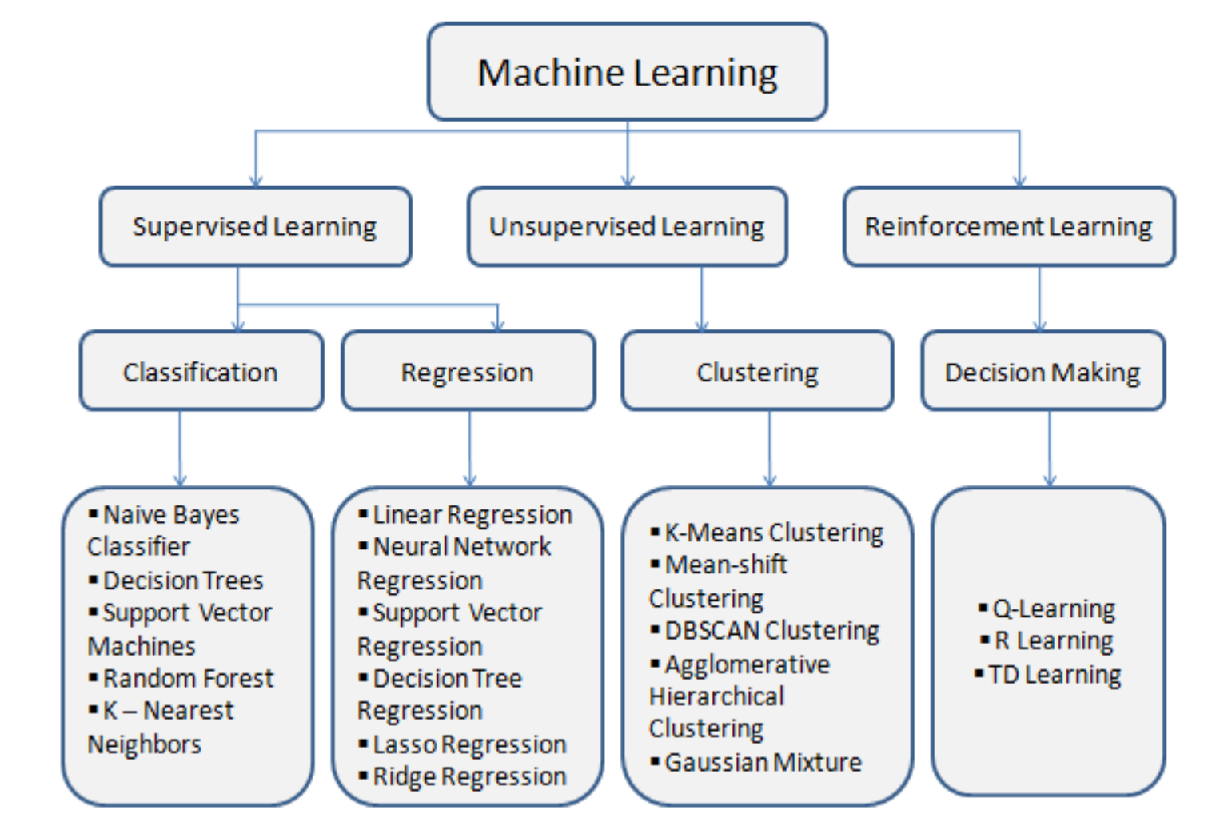
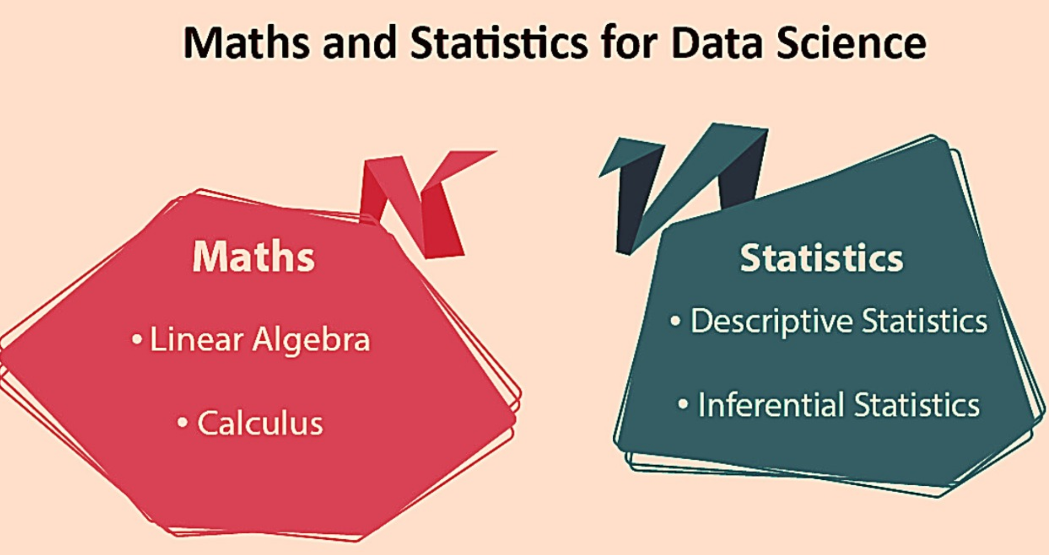
Machine Learning and Statistics
Image credits: HTTPs://cdn-images-1.medium.com/max/800/1*rbaxTrB_CZCqbty_zv2bEg.png
Image Credits: https://editor.analyticsvidhya.com/uploads/18057WhatsApp%20Image%202021-05-31%20at%208.41.43%20PM%20(1).jpeg

Slide 14

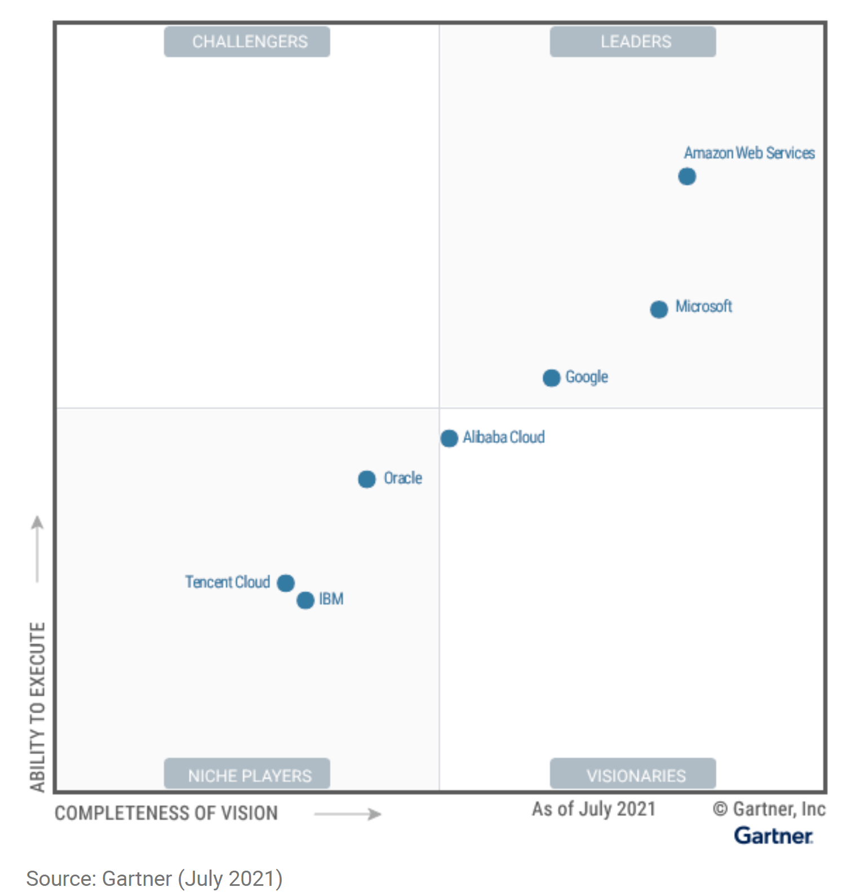


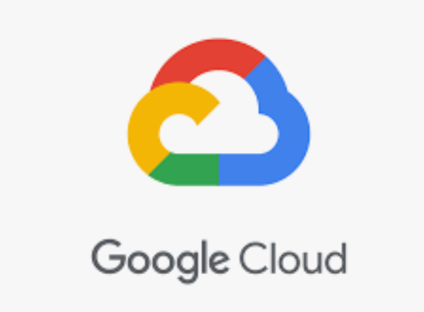
Cloud Computing
Size of image ~proportional to market capture

Slide 15

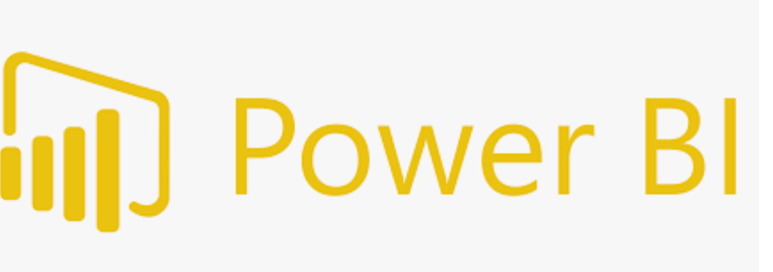

Visualization Tools

Slide 16
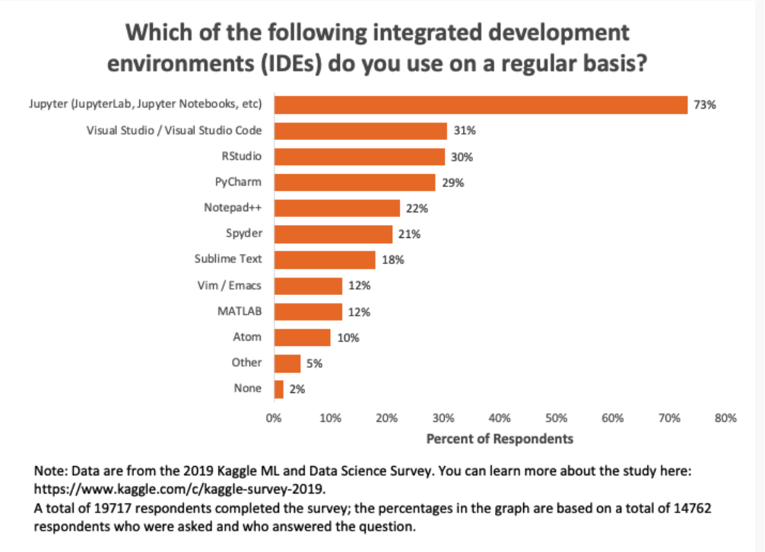
Integrated Development
https://businessoverbroadway.com/wp-content/uploads/2020/07/Kaggle_IDEs_Used_2019.png

Slide 17
Value: Constant Hand Holding & Support
Advantages
We ensure that learner keeps pace with learning and not gets stuck
Quick resolutions of issues whenever learner gets suck studying at home
Stress and hassle free experience of learning anywhere and anytime
Learner Need
Fear of lagging/getting lost /mission out on important deliverables.
For a human companion to guide in the journey
Features
upGrad Buddy for your cohort
Constant Tech Support
Dedicated Grievance Handling team
Q&A forum
Doubt Resolution Sessions

Slide 18
Data Scientist Salaries in India

Slide 19

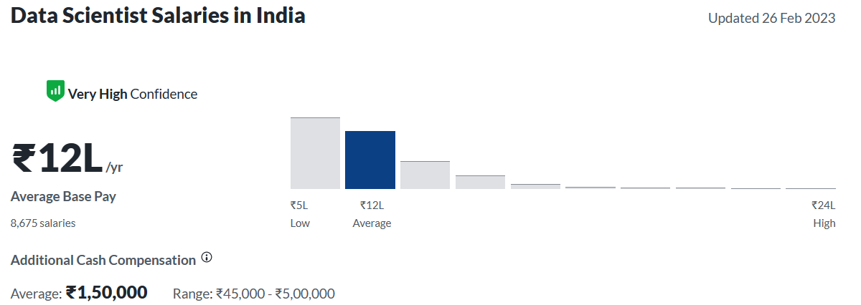
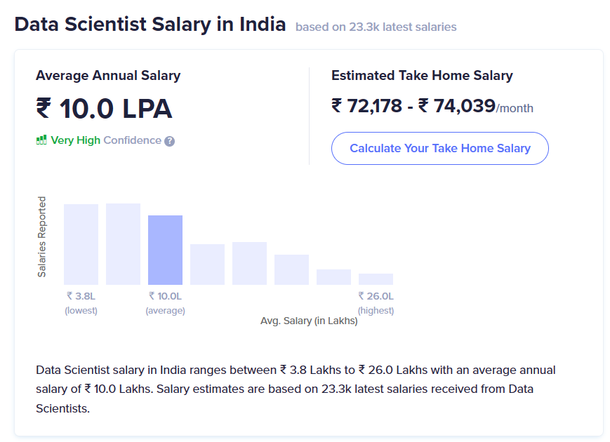

Data Scientist Salaries in India

Slide 20
How to prepare for a data science interview?

Slide 21
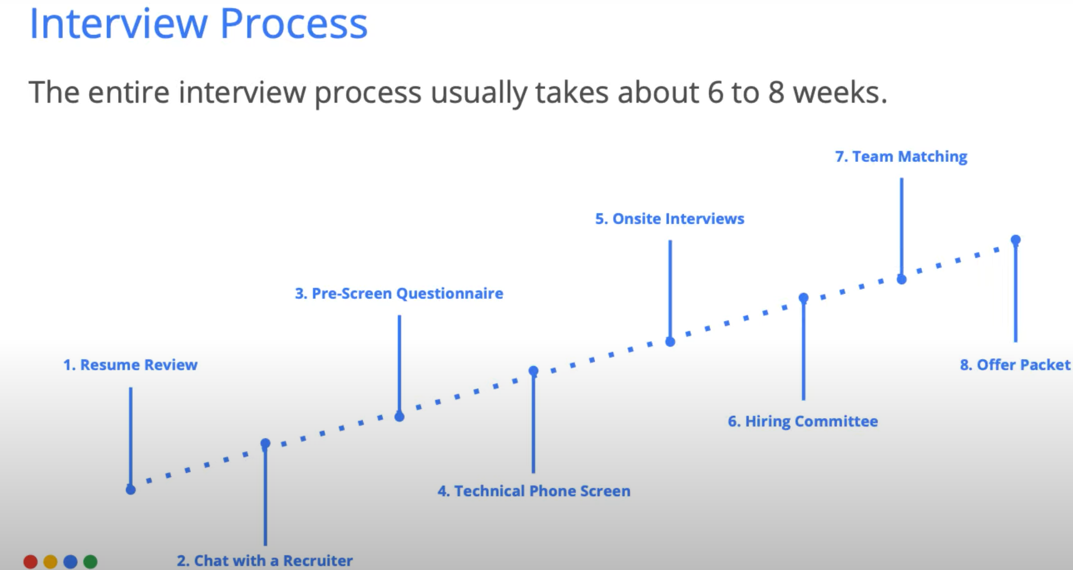
How to prepare for a data science interview?
Resume Review:
YOE
Data Science Projects
Academic Background
Skills
Pre-Screen Questionnaire:
Case Study
Scenario based analytical questions
Technical Phone Screen:
Project Discussion
Applied Machine Learning
Computation skills
Onsite Interviews:
Programming and algorithm skill
Applied Stats & Data Intuition

Slide 22
Value: 100% Career Outcome Oriented Learning
Advantages
Learn only the key skills that will lead to tangible career benefits and not useless content
Learn Hands on applications on skills and not just theoretical knowledge
Learner Need
To feel secured that the study investment
(money, time, effort) will yield career returns
Features
Curriculum based on Industry Needs (SME+ Recruiters)
High Level of Industry Projects/Case Studies/Simulations
Career Oriented PI sessions, 1-1 Mentorship sessions, 1-1 Coaching Sessions

Slide 23
Tips for the transition in Data Science

Slide 24
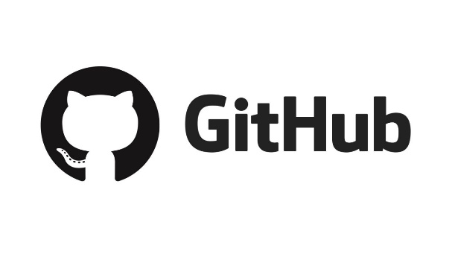

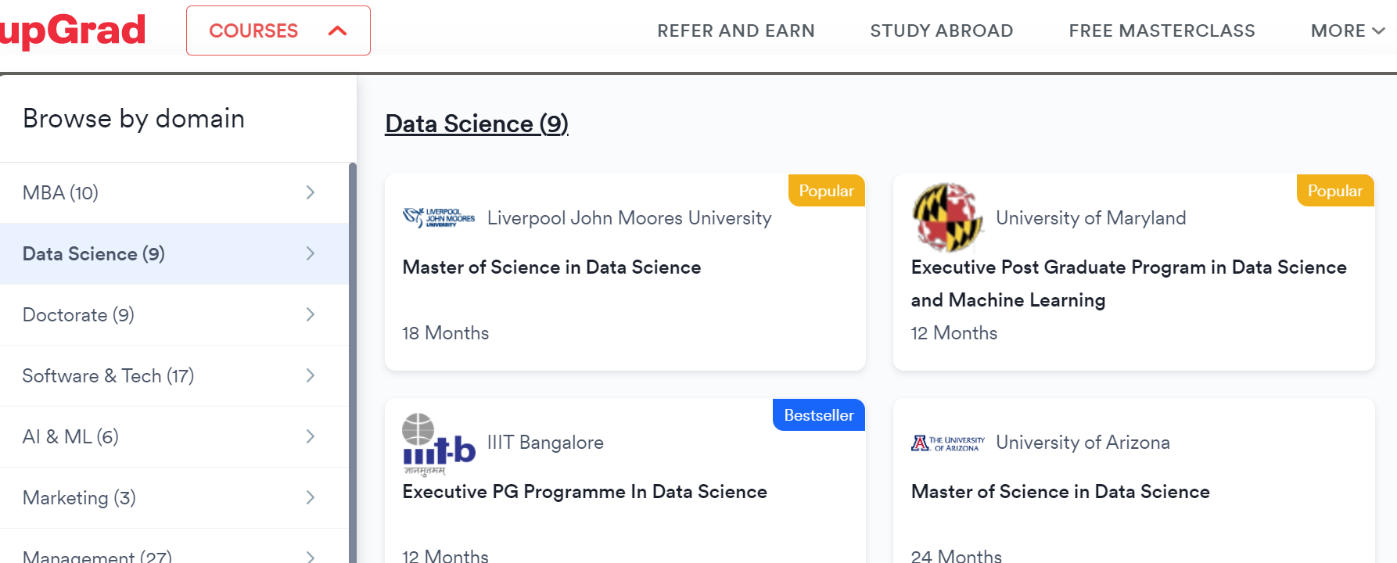
Tips for the transition in Data Science
Building a portfolio of projects:
Creating a portfolio of data science projects can demonstrate your skills to potential employers and help you stand out in the job market.
Networking with other data professionals:
Networking with other data professionals can help you learn about job opportunities and gain insights into the industry.
Seeking out training and education opportunities:
There are many online courses, bootcamps, and degree programs available to help you build your skills in data science.

Slide 25
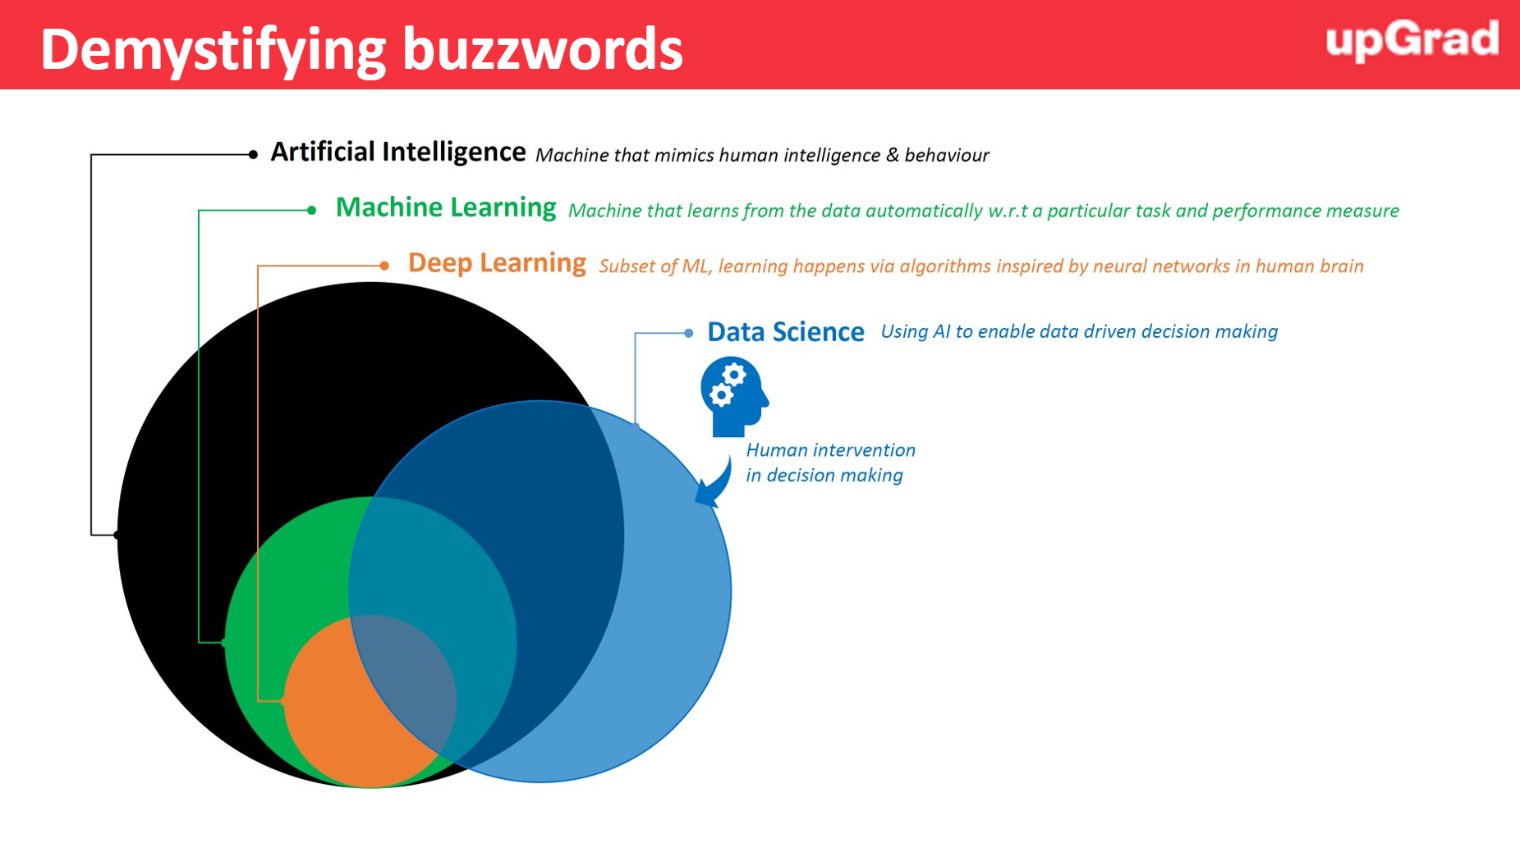
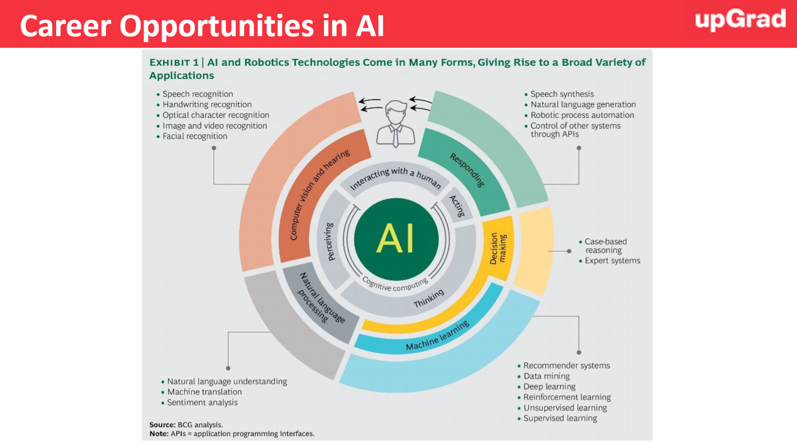
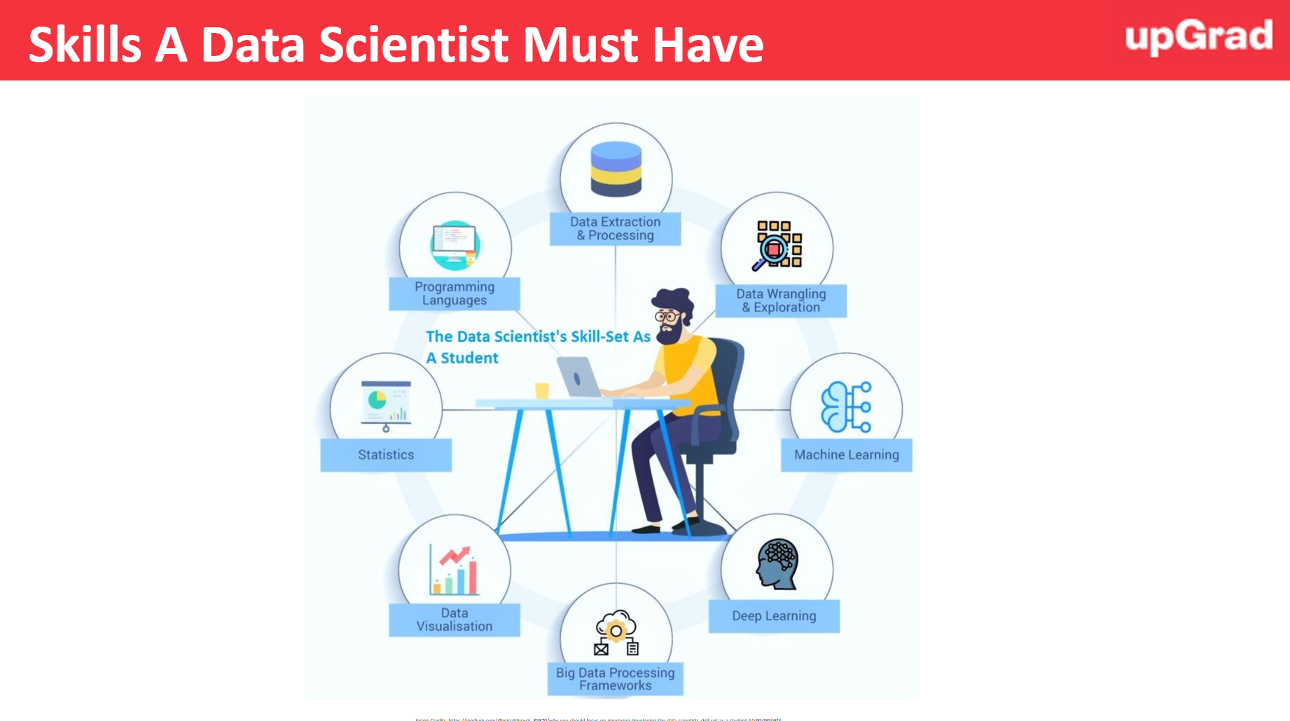
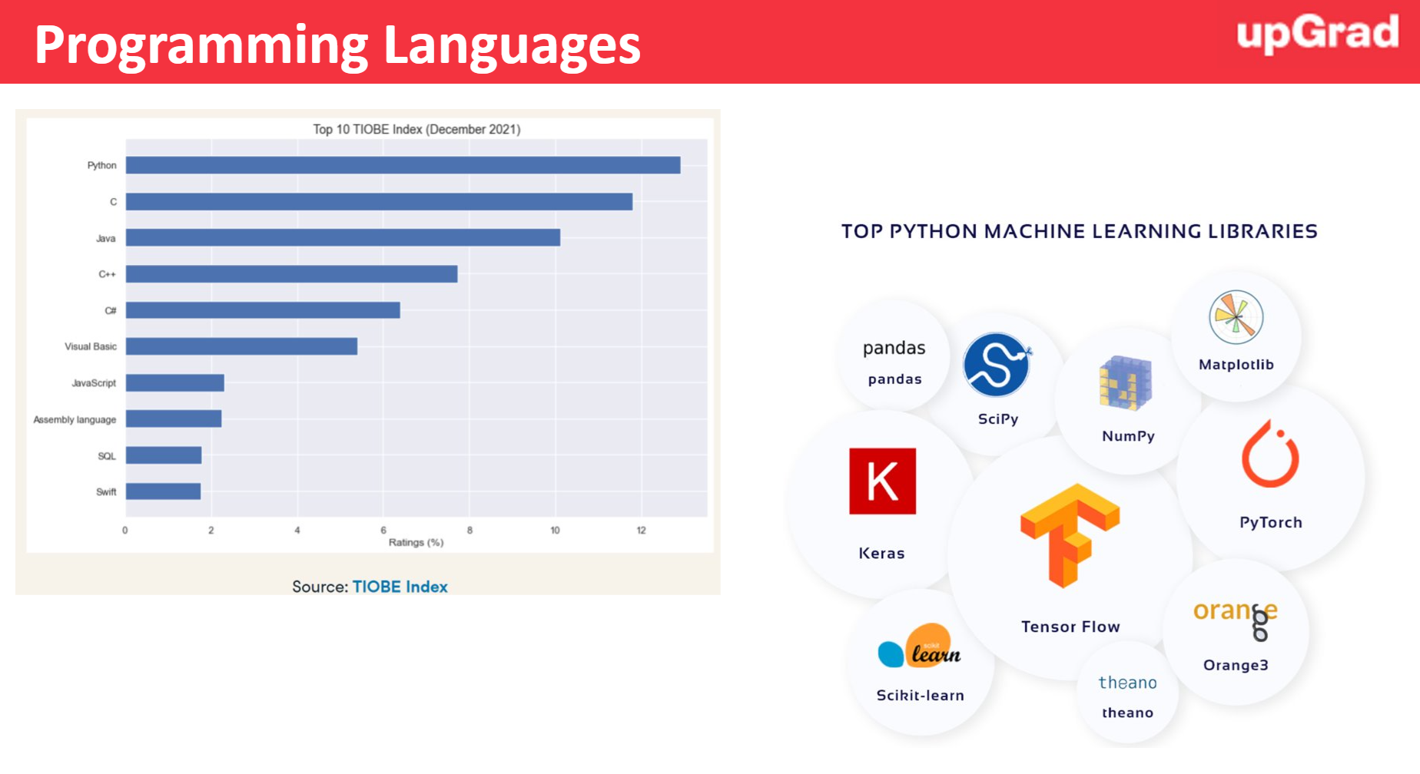
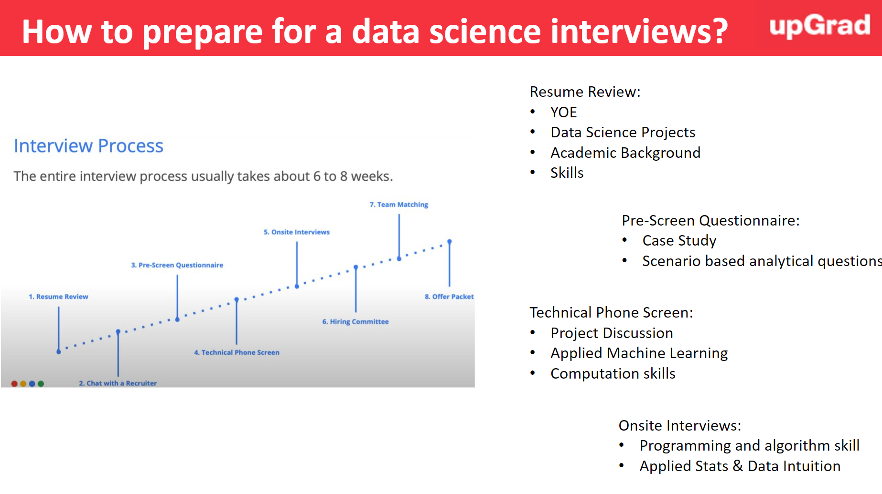
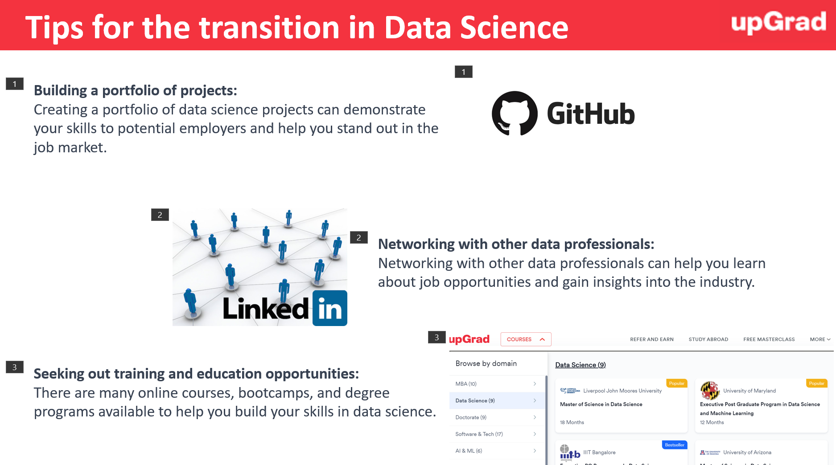
Summary & Key Takeaway

Slide 26
A glance into your journey once you enroll with a Data Science & Machine Learning course
Features Offered
Duration
Program Phase
Access to job portal
High Performance Coaching
6 months - ∞
Alumni Phase
In this phase, the learners has access to course content for 3 years. Frequent online meetups and sessions on trending topics in the field of Data Science are conducted for all alumnus of upGrad
3-6 months
Career Phase (3-6 months after program completion)
Personalized career mentor
LinkedIn Profile and Resume Builder
1:1 Mock Interviews (on request)
In this phase, every learner is assigned a career coach to provide to personalized guidance and action plan to achieve the desired outcomes. Mock-interviews can be scheduled on request basis in a very short time.
Access to job portal
High Performance Coaching
9-12 months
In-program Phase
Daily Doubt Resolution
Every week the learner learns a new concept, practices the concept, and clears graded questions at the time of his/her convenience (through recorded videos and upGrad platform). Exams are conducted twice in the entire program to test the learnings and help learners revise the concepts learnt The learner gets access to job portal and can start applying to the roles of interest. The curriculum is designed in a manner to help gain both hard skills and soft skills to crack the interviews.
Access to learning platform
Live Sessions with top experts
Personalized Industry Mentorship
Access to Job portal
Soft Skills module
Interview Prep
1:1 Mock Interviews (on request)
Pre-Launch Preparatory Phase
0-90 days
Once the learner clears entrance test and enrolls into the program, the learner has access to preparatory content to help revise the important concepts and come into the zone of studying and learning
Access to learning platform

Slide 27


